Slide 1
How Can Development Economics Journals
Better Include Southern Researchers?
Christopher B. Barrett
Cornell University
Co-Editor-in-Chief, Food Policy
September 23, 2022

Slide 2
Development economics peer-reviewed publications overwhelmingly come from HIC authors.
Multiple problems:
Inequity
Increased risk of malpractice, misinterpretation, or misspecification
Less long-term investment in translating research into impact
Hard issue with multiple causes. What to do?

Slide 3
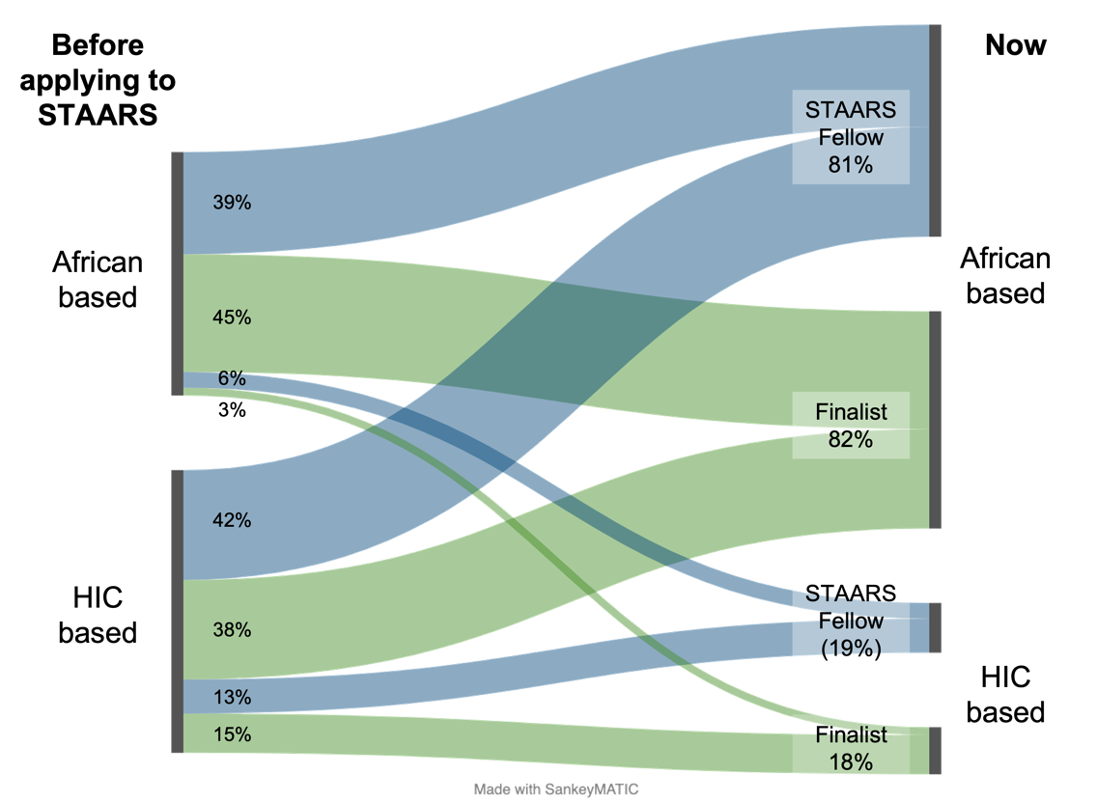
Supply side ideas
Rural non-farm economy
Address the “unwritten curriculum” problem
STAARS Fellows approach
(http://barrett.dyson.cornell.edu/staars/fellows/)
Intensive individual and small group research mentoring and professional development training in a networked model.
Schreiber et al. AEPP 2022

Slide 4
Demand side ideas
Rural non-farm economy
Decolonizing development policy statement … backed up by editors’ actions:
Level 3 copy editing service
LMIC peer reviewer training and recruitment
Directly address through editorial actions
Decolonizing research Food Policy is committed to taking real steps to ensure that its publishing processes are critically engaging with the broader agenda of decolonization research and publishing about disadvantaged populations. We commit to 1. increasing the representation of scholars from underrepresented groups and Low and Middle-Income Countries (LMICs); 2. Ensuring that our editorial board is diverse in terms of disciplines, gender, geography, and underrepresented groups in research
Toward that end, we expect that 1. submissions that use primary or secondary data from LMICs or underrepresented groups invite scholars from those countries or groups to make substantive contributions for earned authorship per the Contributor Role Taxonomy adopted by Elsevier; 2. authors cite LMIC scholars' published work on the subject country; and 3. authors acknowledge LMIC institutions or individuals, or underrepresented groups that provided support at any stage of the research process.

Slide 5
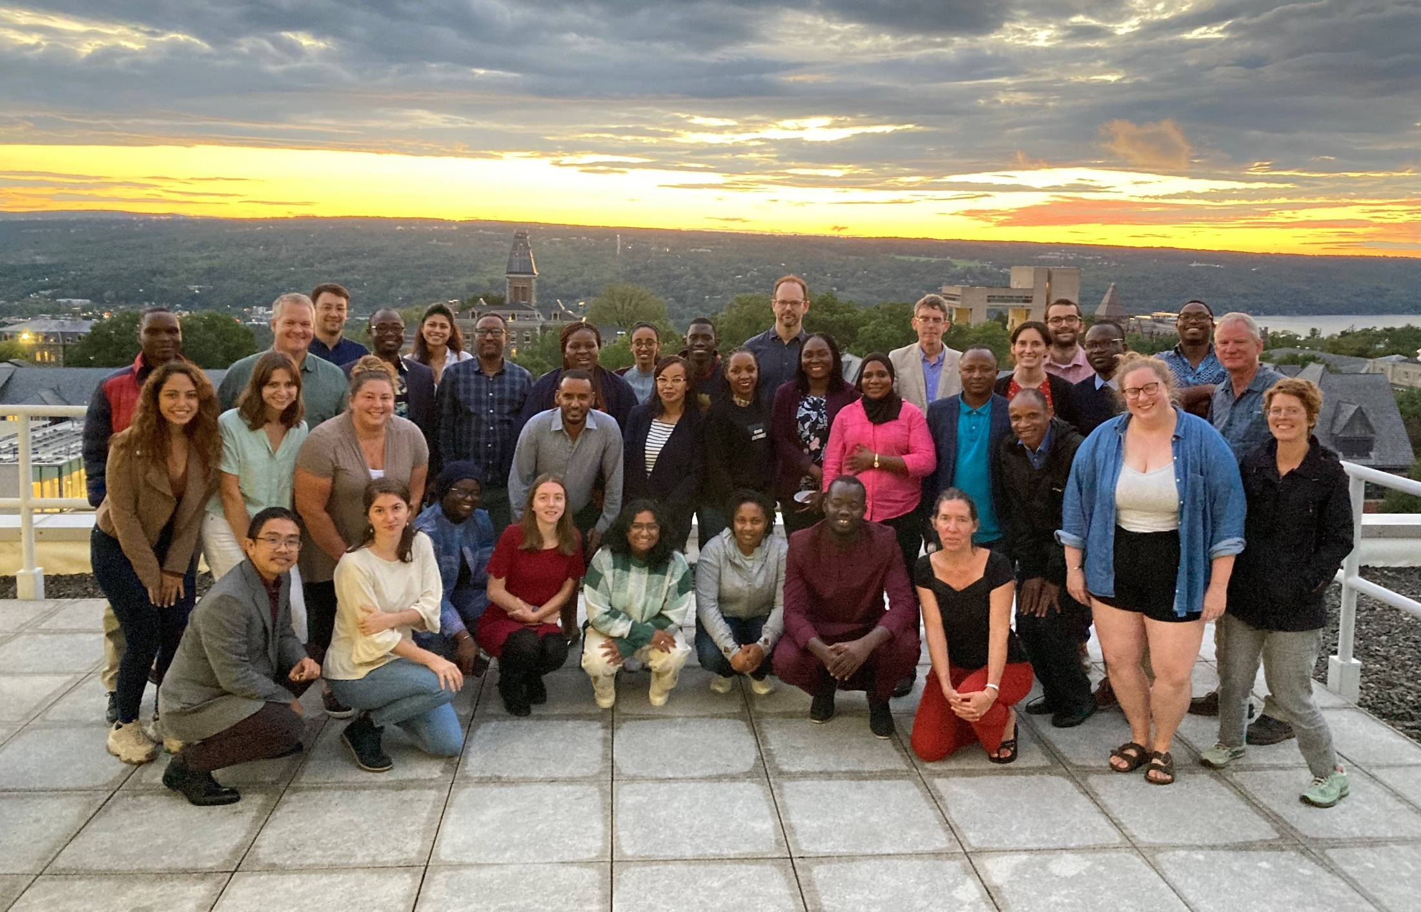
Thank you

